Slide 1


Events

Slide 2




Final Project
Lists and Maps
The River of Java
You are here
Breakout
Events
Graphics/
Animation

Slide 3
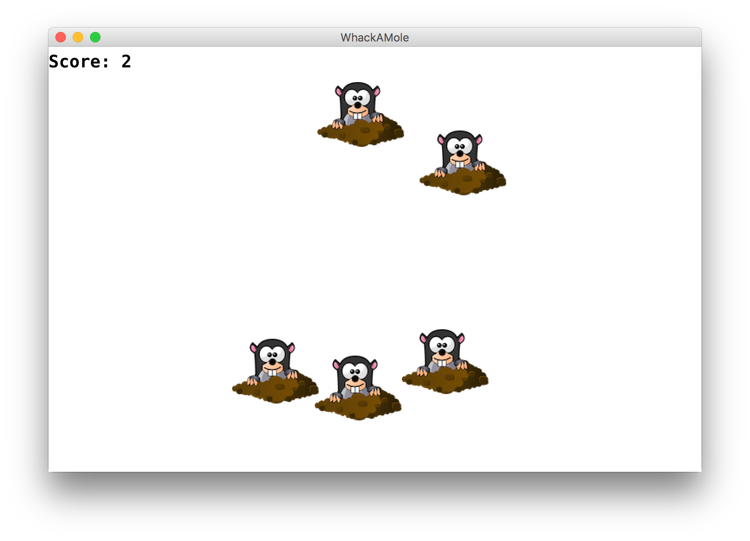
Learning Goals
Learn to respond to mouse events in GraphicsPrograms
Learn to use instance variables to store information outside of methods
Notes:
DEMO

Slide 4
Plan for Today
Event-driven programming
Demo: Click for Daisies
Demo: Doodler
Instance Variables
null and getElementAt
Demo: Whack-a-Mole

Slide 5
Plan for Today
Event-driven programming
Demo: Click for Daisies
Demo: Doodler
Instance Variables
null and getElementAt
Demo: Rubbish Sweeper

Slide 6
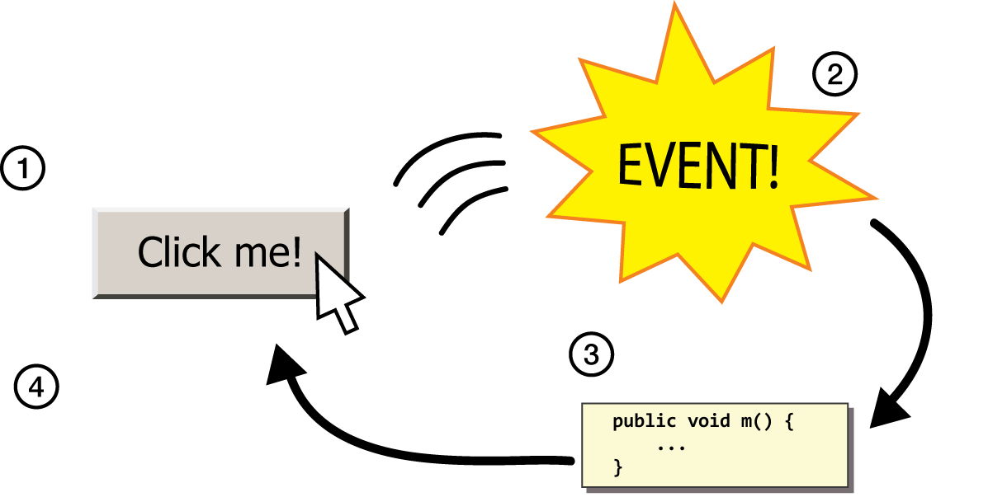
Events
event: Some external stimulus that your program can respond to.
event-driven programming: A coding style (common in graphical programs) where your code is executed in response to user events.

Slide 7
Events
Program launches
Notes:
When that event happens, Java looks for a method in your program called public void run and executes the code there. Today, we’re going to learn about other types of events besides your program launching. There are lots of them! And it turns out you can also have Java run certain code when those things happen, too.

Slide 8
Events
Program launches
Mouse motion
Mouse clicking
Keyboard keys pressed
Device rotated
Device moved
GPS location changed
and more…
Notes:
These are events triggered by the user – like mouse clicks, or mouse drags. On mobile devices, there are even more.
We are now just demoting run to be “another event” that is triggered by the user

Slide 9
Events
Program launches
Mouse motion
Mouse clicking
Keyboard keys pressed
Device rotated
Device moved
GPS location changed
and more…
Notes:
We’re just going to focus on the mouse today.
These can happen in any order – mouse events even after run finishes!

Slide 10
Events
public void run() {
// Java runs this when program launches
}
Notes:
The rule in Java though is that the code for each event needs to go in its own method. That way Java knows what to execute for each event. They also have to be named exactly how Java wants, so it knows where to look. So we have a method for the code that should be run when the program launches (public void run()). And we also will have a method for the code that should run when the user clicks the mouse, and a method that should run when the user drags the mouse, etc.

Slide 11
Events
public void run() {
// Java runs this when program launches
}
public void mouseClicked(MouseEvent event) {
// Java runs this when mouse is clicked
}
Notes:
these new methods also have to be specifically named.

Slide 12
Events
public void run() {
// Java runs this when program launches
}
public void mouseClicked(MouseEvent event) {
// Java runs this when mouse is clicked
}
public void mouseMoved(MouseEvent event) {
// Java runs this when mouse is moved
}
Notes:
these new methods also have to be specifically named.
Just like run, these methods are called by Java, not by our code!

Slide 13
Example: ClickForDaisy
import acm.program.*;
import acm.graphics.*;
import java.awt.*;
import java.awt.event.*; // NEW
public class ClickForDaisy extends GraphicsProgram {
public void run() {
addMouseListeners();
}
// Add a Daisy image at 50, 50 on mouse click
public void mouseClicked(MouseEvent event) {
GImage daisy = new GImage("res/daisy.png", 50, 50);
add(daisy);
}
}
Notes:
No run method!
Make sure prototype is exact!
Show working program.
Adds daisies always at the same location
This is nice, but not very exciting if we can only add a Daisy image at one location. It would be cool if we could get information about the event that just happened. Luckily, we can! You’ll notice something different here from run() – it takes a parameter! This is because when an event happens, Java will call our method and pass us some information about the event in this parameter.

Slide 14
addMouseListeners()
You must call addMouseListeners() in your run method if you want to respond to mouse events in your program.
After this is called, your program will start “listening” for mouse events.

Slide 15
MouseEvent Objects
A MouseEvent contains information about the event that just occurred:
Method | Description
e.getX() | the x-coordinate of mouse cursor in the window
e.getY() | the y-coordinate of mouse cursor in the window
Notes:
Let’s try to use this parameter to make our ClickForDaisy program better – let’s add Daisy wherever the user clicks the mouse!

Slide 16
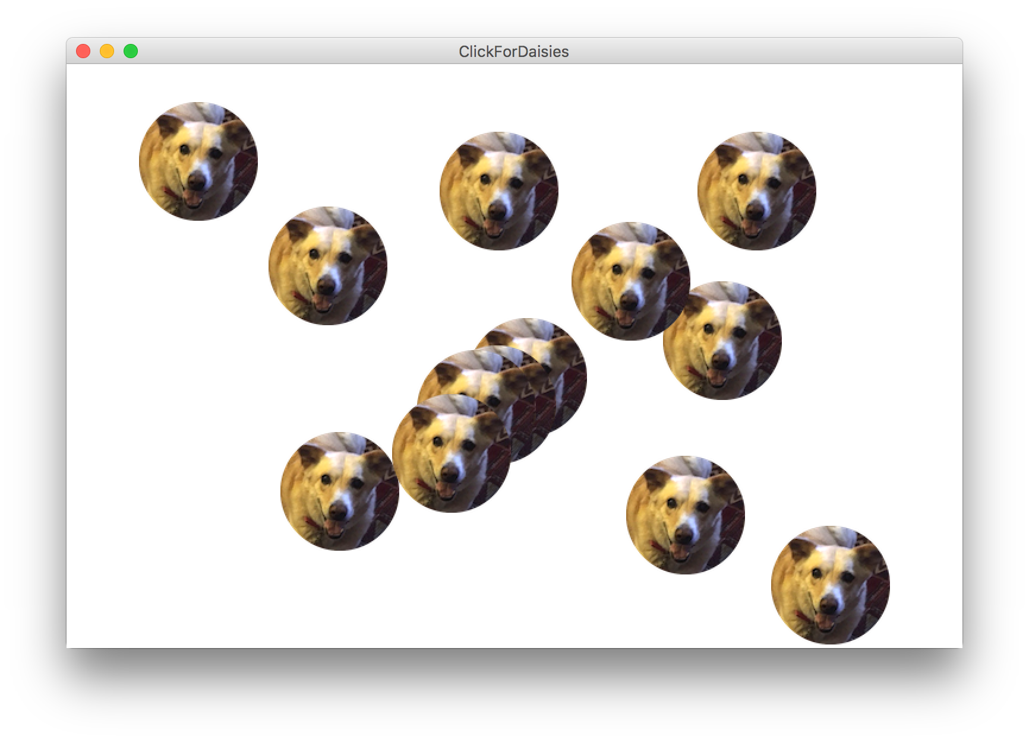
Example: ClickForDaisies
Notes:
How would we do this?

Slide 17
Example: ClickForDaisies
public class ClickForDaisies extends GraphicsProgram {
// Add a Daisy image where the user clicks
public void mouseClicked(MouseEvent event) {
// Get information about the event
double mouseX = event.getX();
double mouseY = event.getY();
// Add Daisy at the mouse location
GImage daisy = new GImage("res/daisy.png", mouseX, mouseY);
add(daisy);
}
}

Slide 18
Example: ClickForDaisies
public class ClickForDaisies extends GraphicsProgram {
// Add a Daisy image where the user clicks
public void mouseClicked(MouseEvent event) {
// Get information about the event
double mouseX = event.getX();
double mouseY = event.getY();
// Add Daisy at the mouse location
GImage daisy = new GImage("res/daisy.png", mouseX, mouseY);
add(daisy);
}
}
Notes:
One problem – where does Daisy show up?
Show working program.

Slide 19
Types of Mouse Events
There are many different types of mouse events.
Each takes the form: public void eventMethodName(MouseEvent event) { ...
Method | Description
mouseMoved | mouse cursor moves
mouseDragged | mouse cursor moves while button is held down
mousePressed | mouse button is pressed down
mouseReleased | mouse button is lifted up
mouseClicked | mouse button is pressed and then released
mouseEntered | mouse cursor enters your program's window
mouseExited | mouse cursor leaves your program's window
Notes:
We’ve just talked about mouseClicked – there are many other types of mouse events you can react to!
You can detect multiple events, but multiple mouse events can’t happen simultaneously
HOWEVER – run can execute simultaneously with mouse events
mouse dragged called many times while mouse is dragged – we can take advantage of this!

Slide 20
Plan for Today
Event-driven programming
Demo: Click for Daisies
Demo: Doodler
Instance Variables
null and getElementAt
Demo: Whack-a-Mole

Slide 21
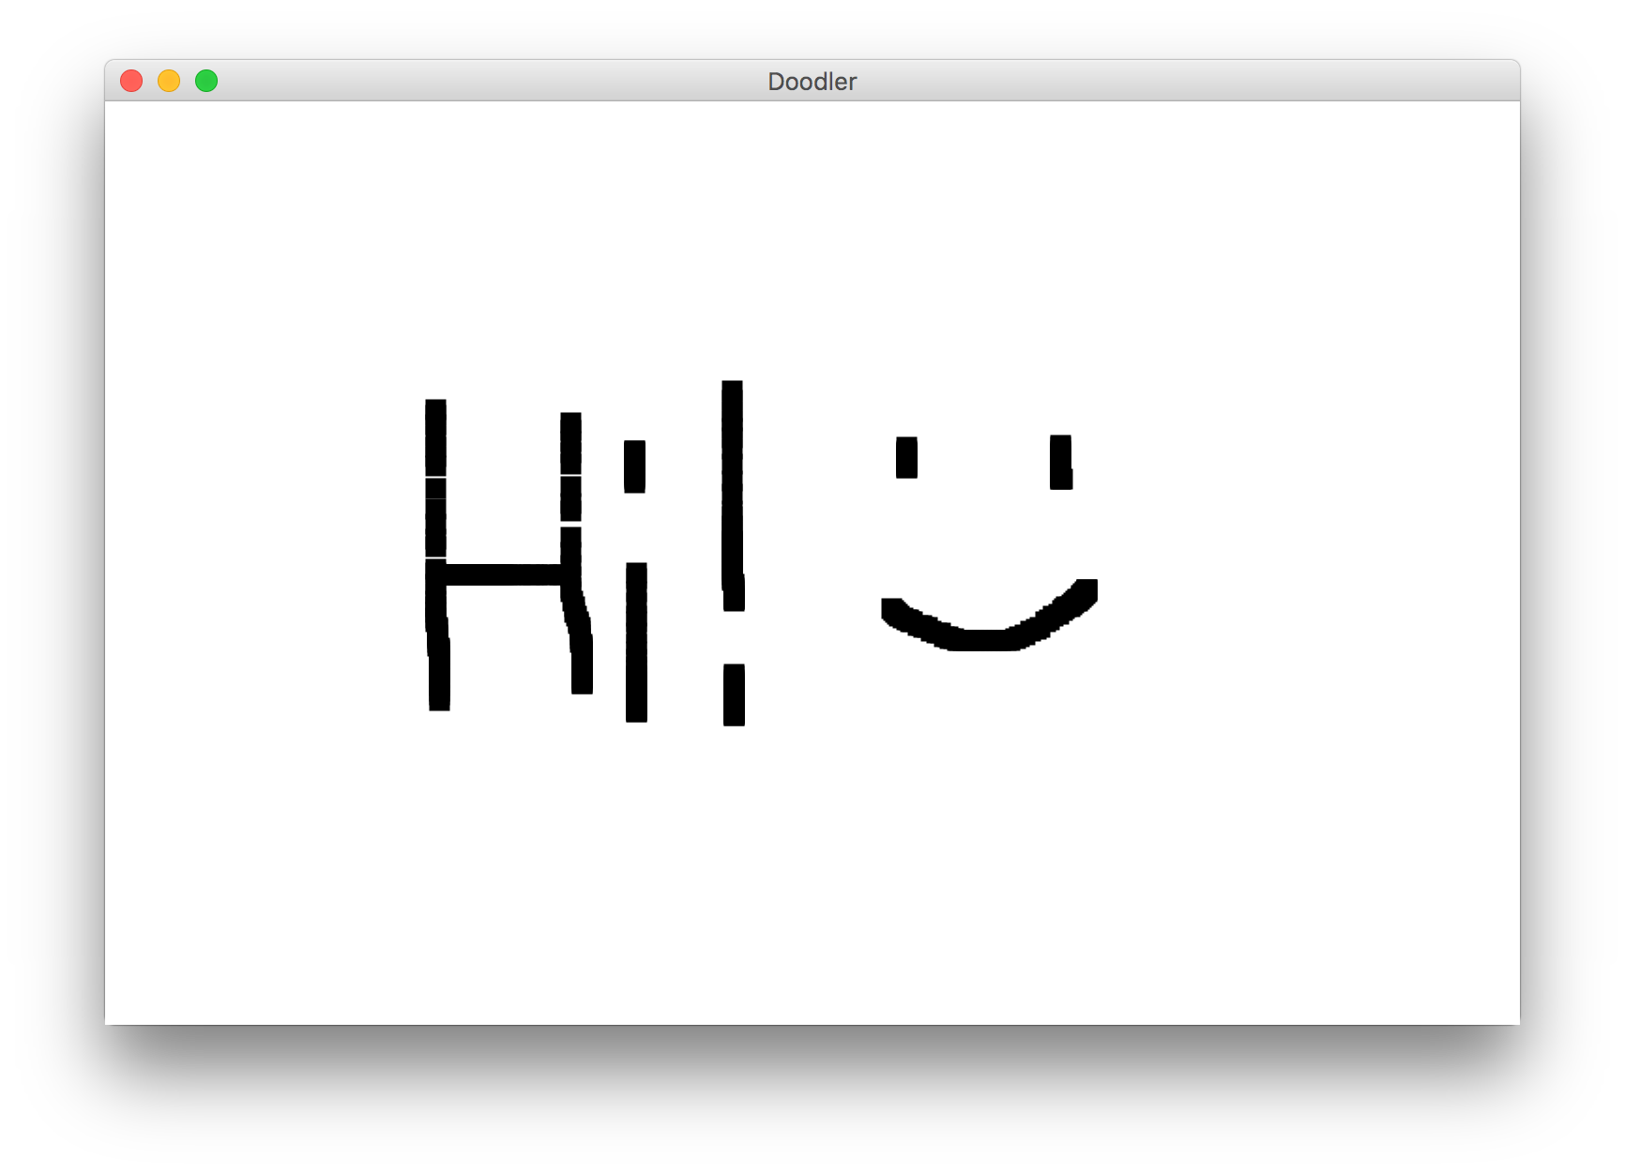
Coding Together: Doodler
Notes:
Let’s look at an example with mouseDragged – let’s write a program that lets the user drag the mouse and drag
LIVE CODE

Slide 22
Doodler
private static final int SIZE = 10;
...
public void mouseDragged(MouseEvent event) {
double mouseX = event.getX();
double mouseY = event.getY();
double rectX = mouseX – SIZE / 2.0;
double rectY = mouseY – SIZE / 2.0;
GRect rect = new GRect(rectX, rectY, SIZE, SIZE);
rect.setFilled(true);
add(rect);
}
Notes:
Let’s step through

Slide 23
Doodler
public void mouseDragged(MouseEvent event) {
double mouseX = event.getX();
double mouseY = event.getY();
double rectX = mouseX – SIZE / 2.0;
double rectY = mouseY – SIZE / 2.0;
GRect rect = new GRect(rectX, rectY, SIZE, SIZE);
rect.setFilled(true);
add(rect);
}

Slide 24
Doodler
public void mouseDragged(MouseEvent event) {
double mouseX = event.getX();
double mouseY = event.getY();
double rectX = mouseX – SIZE / 2.0;
double rectY = mouseY – SIZE / 2.0;
GRect rect = new GRect(rectX, rectY, SIZE, SIZE);
rect.setFilled(true);
add(rect);
}

Slide 25
Doodler
public void mouseDragged(MouseEvent event) {
double mouseX = event.getX();
double mouseY = event.getY();
double rectX = mouseX – SIZE / 2.0;
double rectY = mouseY – SIZE / 2.0;
GRect rect = new GRect(rectX, rectY, SIZE, SIZE);
rect.setFilled(true);
add(rect);
}

Slide 26
Doodler
public void mouseDragged(MouseEvent event) {
double mouseX = event.getX();
double mouseY = event.getY();
double rectX = mouseX – SIZE / 2.0;
double rectY = mouseY – SIZE / 2.0;
GRect rect = new GRect(rectX, rectY, SIZE, SIZE);
rect.setFilled(true);
add(rect);
}
Notes:
Show working program – question: why does it slow down when I move faster?

Slide 27
Recap: Events
1) User performs some action, like moving / clicking the mouse.
2) This causes an event to occur.
3) Java executes a particular method to handle that event.
4) The method's code updates the screen appearance in some way.
Notes:
This whole concept is called event-driven programming, and is a common way to write Graphics programs, since users can interact with them and you want to do things when they interact with them.
This is different from how we have programmed so far, because unlike with run() we don’t know when our code will execute! It could be in any order.

Slide 28
Revisiting Doodler
public void mouseDragged(MouseEvent event) {
double mouseX = event.getX();
double mouseY = event.getY();
double rectX = mouseX – SIZE / 2.0;
double rectY = mouseY – SIZE / 2.0;
GRect rect = new GRect(rectX, rectY, SIZE, SIZE);
rect.setFilled(true);
add(rect);
}
What if we wanted the same GRect to track the mouse, instead of making a new one each time?
Notes:
No way to do this! We can’t pass parameters since we don’t call mouse event methods
No way for information to live between mouse dragged calls – no variables live then!
No way to access information about previous drag

Slide 29
Plan for Today
Event-driven programming
Demo: Click for Daisies
Demo: Doodler
Instance Variables
null and getElementAt
Demo: Whack-a-Mole

Slide 30
Instance Variables
private type name; // declared outside of any method
Instance variable: A variable that lives outside of any method.
The scope of an instance variable is throughout an entire file (class).
Useful for data that must persist throughout the program, or that cannot be stored as local variables or parameters (event handlers).
It is bad style to overuse instance variables
Notes:
Because they have a large scope, it is considered bad style to use too many instance variables, or to make something an instance variable that could instead be a local variable, parameter, return, etc.

Slide 31
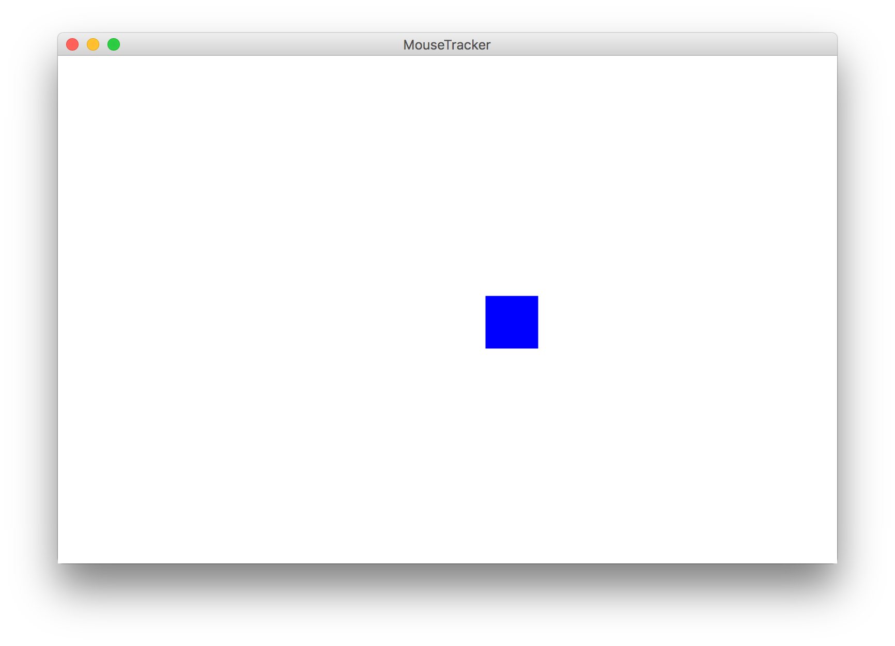
Example: MouseTracker
Notes:
Write mouseTracker with creating Grect in run, moving grect in mouse moved. Then, show that we can’t access Grect in mouse moved. We need a field! Show code.

Slide 32
Plan for Today
Event-driven programming
Demo: Click for Daisies
Demo: Doodler
Instance Variables
null and getElementAt
Demo: Whack-a-Mole

Slide 33
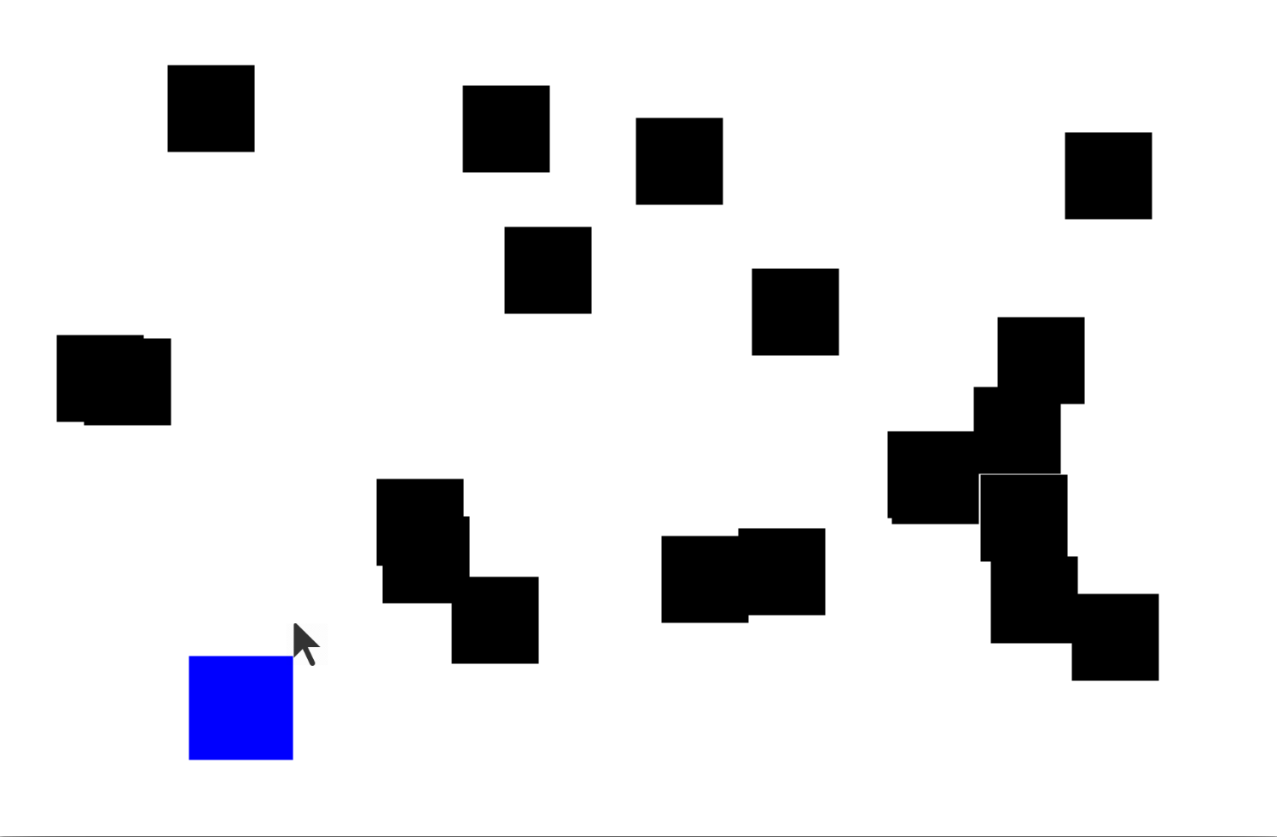
getElementAt

Slide 34
getElementAt
getElementAt returns the object at this location on the canvas
GObject objectHere = getElementAt(x, y);
Notes:
What is there is no object? How can we check that?

Slide 35
getElementAt
getElementAt returns the object at this location on the canvas
GObject objectHere = getElementAt(x, y);
if (objectHere != null) {
// do something with objectHere
} else {
// null – nothing at that location
}
Notes:
This is how we can finish dribbleCastle!

Slide 36
Null
Null is a special variable value that objects can have that means “nothing”. Primitives cannot be null.
If a method returns an object, it can return null to signify “nothing”. (just say return null;)
// may be a GObject, or null if nothing at (x, y)
GObject maybeAnObject = getElementAt(x, y);
Notes:
Different from the empty string

Slide 37
Null
You can check if something is null using == and !=.
// may be a GObject, or null if nothing at (x, y)
GObject maybeAnObject = getElementAt(x, y);
if (maybeAnObject != null) {
// do something with maybeAnObject
} else {
// null – nothing at that location
}
Notes:
This is how we can finish dribbleCastle!

Slide 38
Null
Calling methods on an object that is null will crash your program!
// may be a GObject, or null if nothing at (x, y)
GObject maybeAnObject = getElementAt(x, y);
if (maybeAnObject != null) {
int x = maybeAnObject.getX(); // OK
} else {
int x = maybeAnObject.getX(); // CRASH!
}
Notes:
Think about null like an “invalid mailing address” – if you try to send messages to it, your messages bounce because the address is invalid

Slide 39
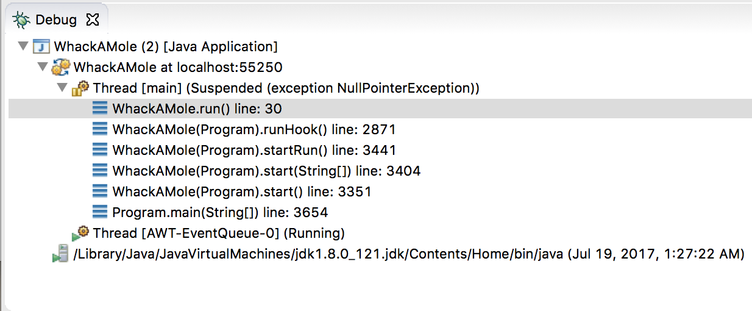
Null
Calling methods on an object that is null will crash your program! (throws a NullPointerException)

Slide 40
Putting it all together

Slide 41
Whack-A-Mole
Let’s make Whack-A-Mole!
Moles should initially appear at random locations on the screen
If the user clicks a mole, remove it

Slide 42
Whack-A-Mole
Let’s add to our program by continuously adding more moles as the game plays.
Notes:
Live code

Slide 43

Normal Program
Run Method

Slide 44
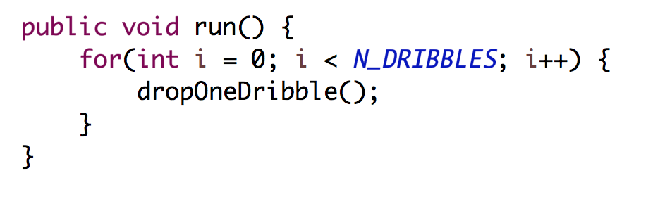
Normal Program
Run Method
public void run() {
while(true) {
update();
pause(DELAY);
} }

Slide 45
Normal Program
Run Method
public void run() {
while(true) {
update();
pause(DELAY);
} }

Slide 46
Normal Program
Run Method
public void run() {
while(true) {
update();
pause(DELAY);
} }

Slide 47
Normal Program
Run Method
public void run() {
while(true) {
update();
pause(DELAY);
} }

Slide 48
Normal Program
Run Method
public void run() {
while(true) {
update();
pause(DELAY);
} }

Slide 49
Normal Program
Run Method

Slide 50


New Listener Characters
Mouse Listener
Mouse Moved Method

Slide 51
Program with a Mouse Method
Run Method
Mouse Moved Method

Slide 52
Program Starts Running
Run Method
Mouse Moved Method

Slide 53
Add Mouse Listener
Run Method
Mouse Moved Method
Mouse Listener
addMouseListeners();

Slide 54
Program Runs as Usual
Run Method
Mouse Moved Method
Mouse Listener

Slide 55

Mouse Moved!
Run Method
Mouse Moved Method
Mouse Listener

Slide 56
Calls Mouse Moved Method
Run Method
Mouse Moved Method
Mouse Listener

Slide 57
When done, Run continues.
Run Method
Mouse Moved Method
Mouse Listener

Slide 58
Keeps Doing Its Thing…
Run Method
Mouse Moved Method
Mouse Listener

Slide 59
Mouse Moved!
Run Method
Mouse Moved Method
Mouse Listener

Slide 60
Calls Mouse Moved Method
Run Method
Mouse Moved Method
Mouse Listener

Slide 61
When done, Run continues.
Run Method
Mouse Moved Method
Mouse Listener

Slide 62
Recap
Event-driven programming
Demo: Click for Daisies
Demo: Doodler
Instance Variables
null and getElementAt
Demo: Whack-a-Mole

